Slide 1
RMIFC Daily Brief
(Antananarivo - Madagascar)
June 28th 2024
"Even the glory of the river ends at the sea", Russian proverb.

Slide 2

ACTIVITIES
Today
Nil
Current events
Bellbuoy 24 Exercise
Events to come
Nil
Duty Officer: ILO France
oli.france@crfimmadagascar.org

Slide 3
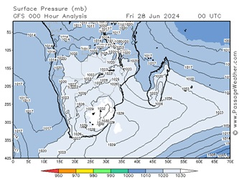
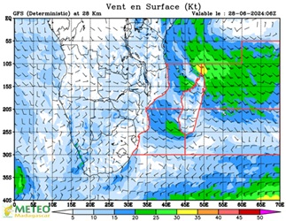
WEATHER FORECAST
HIGH SEAS FORECAST ISSUED BY METEO MADAGASCAR ON 2024/06/28 AT 09 UTC
B.1. WARNING: NEAR GALE WARNING NEAR CAP OF AMBRE.
B.2 SYNOPTIC SITUATIONS AT 06 UTC.
- LOW PRESSURE NORTH OF 10S ;
- HIGH 1030 HPA CENTERED BY 32S/34E, EXTENDED BY A RIDGE SOUTHERN OF THE MASCARENE ISLANDS.
B.3 FORECAST VALID FROM 2024/06/28 AT 10 UTC TO 2024/06/29 AT 10 UTC.
3.1 DURBAN EAST (32.5S/25S, EAST COAST/55E):
WIND: SOUTH-WESTERLY 05/15 KT IN THE SOUTH-EASTERN, OTHERWISE EAST TO SOUTH-EASTERLY 10/15 KT REACHING 20/25 KT IN THE NORTH-CENTRAL PARTS BUT NORTH-EASTERLY 10/20 KT IN THE SOUTH-WESTERN.
VIS: MODERATE IN SHOWERS IN PLACES.
SEA STATE: 3.0 TO 3.5M IN THE SOUTH-EAST, SOUTH-WESTERLY SWELLS.
3. INDIAN OCEAN:
05S/20S:
WIND: SOUTH-EASTERLY 20/25 KT, REACHING 30 KT OVER THE EXTREME NORTH-WESTERN AREA.
SEA STATE: ROUGH TO VERY ROUGH. MODERATE SOUTH-EASTERLY SWELLS.
WEATHER: ISOLATED SHOWERS NORTHERN OF 10S. PARTLY CLOUDY ELSEWHERE.
20S/30S:
WIND: SOUTH TO SOUTH-WESTERLY 10/15 KT BECOMING SOUTH-EASTERLY 05/15 KT NORTHERN OF 25S.
SEA STATE: MODERATE TO ROUGH. SOUTH TO SOUTH-WESTERLY SWELLS.
WEATHER: LOCAL LIGHT RAIN.
4. MOZAMBIQUE CANAL:
10S/20S:
WIND: SOUTH TO SOUTH-EASTERLY 10/15 KT, LOCALLY 20 KT, REACHING 25/30 KT OVER THE EXTREME NORTH-EASTERN AREA.
SEA STATE: SLIGHT TO MODERATE.
WEATHER: RARE SHOWERS NEAR THE AFRICAN COASTS. PARTLY CLOUDY TO SUNNY ELSEWHERE.
20S/30S:
WIND: SOUTH-EASTERLY 15/25 KT TURNING NORTH-EASTERLY 15/20 KT OVER THE EXTREME SOUTH-WESTERN AREA.
SEA STATE: MODERATE TO ROUGH. SOUTH-WESTERLY SWELLS.
WEATHER: PARTLY CLOUDY TO SUNNY.

Slide 4
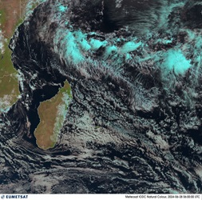
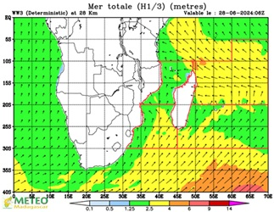
WEATHER FORECAST
FORECAST FOR THE SOUTHERN TERRITORIES AND ISLANDS VALID FROM 20240628 06 UTC TO 20240629 AT 06 UTC:
WAM (30S/40S,50E/65E) :
FEW SHOWERS BECOMING MORE FREQUENT OVER SOUTHERN LATER.
WIND : W TO SW 6/7 OVER SOUTHERN, LOCALLY 8 OVER FAR SOUTHERN LATER. SEVERE GUSTS. SW 4/5 OVER NORTHERN, DECREASING 3/4 OVER NORTH-WESTERN AT END.
SEA : ROUGH TO VERY ROUGH FROM NORTH TO SOUTH, LOCALLY HIGH OVER FAR SOUTHERN. LONG SW SWELL, 3/5 M.
VISI : POOR UNDER PRECIPITATION.
AMS (30S/40S,65E/80E) :
FRONTAL RAINS AND SHOWERS WITH CH LEAVING THE AREA AT FIRST THEN OVER
SOUTHERN AT END WITH CF.
WIND : W 5 TO 7 FROM NORTH TO SOUTH LOCALLY 8 AT END OVER SOUTHERN. SEVERE GUSTS.
SEA : ROUGH TO VERY ROUGH, LOCALLY HIGH BY SOUTHWESTERN. SW SWELL 3/5M BY WESTERN.
VISI : POOR UNDER PRECIPITATION.
Assessment
1. Mozambican Channel. Locally Favourable for illicit activities (illegal fishing and smuggling)
Sector 1 – Sea state : Rough to Very Rough. (3 m < WAVES <5 m).
2. East Coast, Locally Favourable for illicit activities
Sector 3 – Sea state : Rough to Very Rough. (3 m < WAVES <5 m).

Slide 5

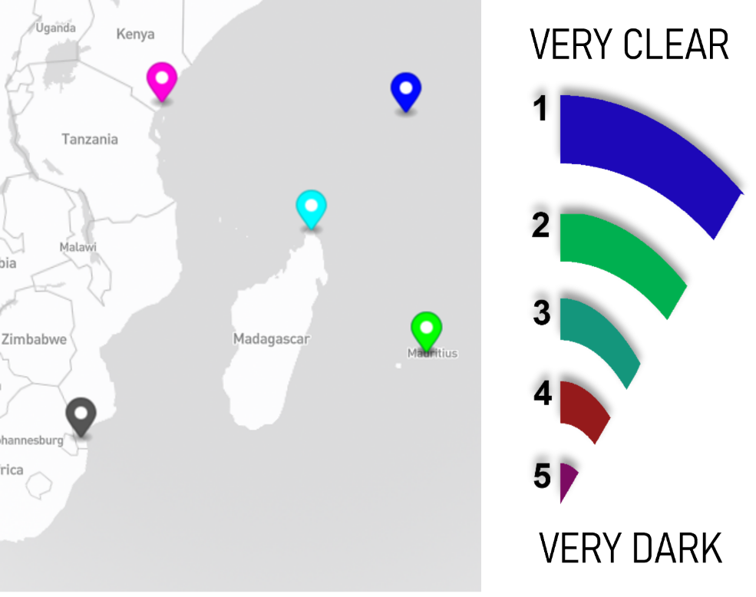








PERIOD OF DARKNESS (POD)
Victoria (UTC +4)
Mombasa (UTC +3)
Antsiranana (UTC +3)
Maputo (UTC +2)
Port Louis (UTC +4)
Mozambique Channel Period of Darkness: 07:10 18:30 p.m. to 01:40 a.m. | Indian Ocean Period of Darkness: 06:50 19:00 p.m. to 01:50 a.m.

Slide 6
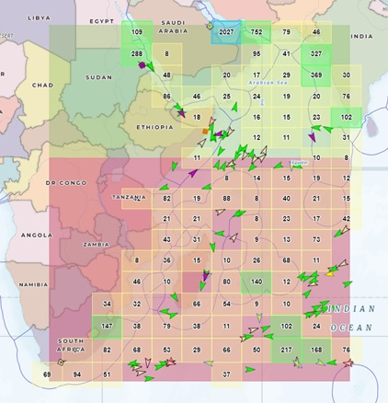
RMIFC RMP (Recognized Maritime Picture)
 | G | R
▲ Reserved, Square, Other, Unknow | 1828 | 866
▲ Wing In Ground Crafts | 9 | 1
▲ Fishing | 507 | 364
▲ Towing, Dredging, Military, Sailboat | 158 | 10
▲ Diving | 25 | 2
▲ Pleasure Crafts | 400 | 76
▲ High Speed Crafts | 75 | 3
▲ Pilot | 56 | 12
▲Search and Rescue Crafts | 9 | 9
▲ Tug | 722 | 62
▲ Port Tender Crafts | 23 | 9
▲ Anti-Pollution, Law, Medical, Non-Conflict | 22 | 3
▲ Passenger | 129 | 25
▲ Cargo | 2443 | 1220
▲ Tanker | 1429 | 340
Total | 7835 | 3002
RMIFC comment:
The RMIFC draws the attention of vessels transiting in its area of responsibility to be vigilant and take the necessary measures in view of the few attempts to approach vessels by pirates in the area at HR and the relative excesses and political tensions in Yemen
L’IMR dynamique (Utilisation de google earth) où toutes les informations peuvent être lues en cliquant sur les points bleus est envoyée en complément de ce briefing.
Number of the fishing vessels : 364
28th June 2024 10:25
Source AIS: SeaVision
R : Restricted area of interest - This area is defined as the one in which existing means allow intervention G : General area of interest

Slide 7
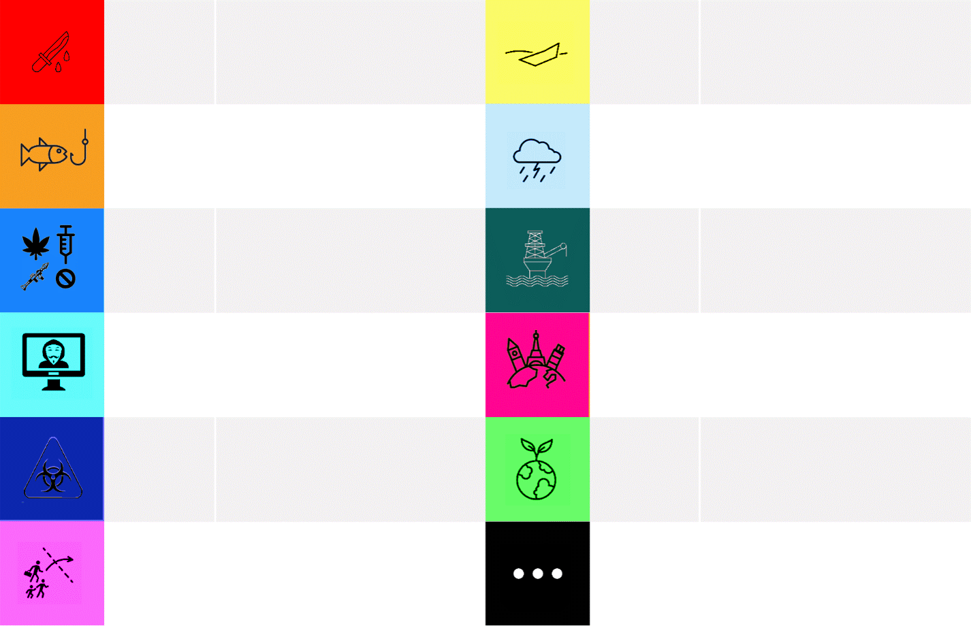
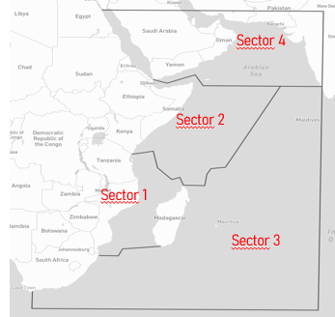

Events reports
 | General Area of interest and sectors of the RMIFC
1
Violent acts
at sea
3
Maritime incidents
1
IUU Fishing
1
Maritime natural event / AHSC
1
Smuggling & contraband
2
Maritime critical infrastructure
Maritime cybercrime
Pleasure /
Maritime tourism
Weapons
proliferation
2
Marine environment
Irregular migration & smuggling of migrants by sea
2
Others
For any maritime information concerning the Western Indian Ocean = INFO (for information)
For all activities at sea without the intervention of an intervention means = ACT (for Activities)
For all activities at sea with the intervention of at least one means of intervention = OPS (for Operations)

Slide 8
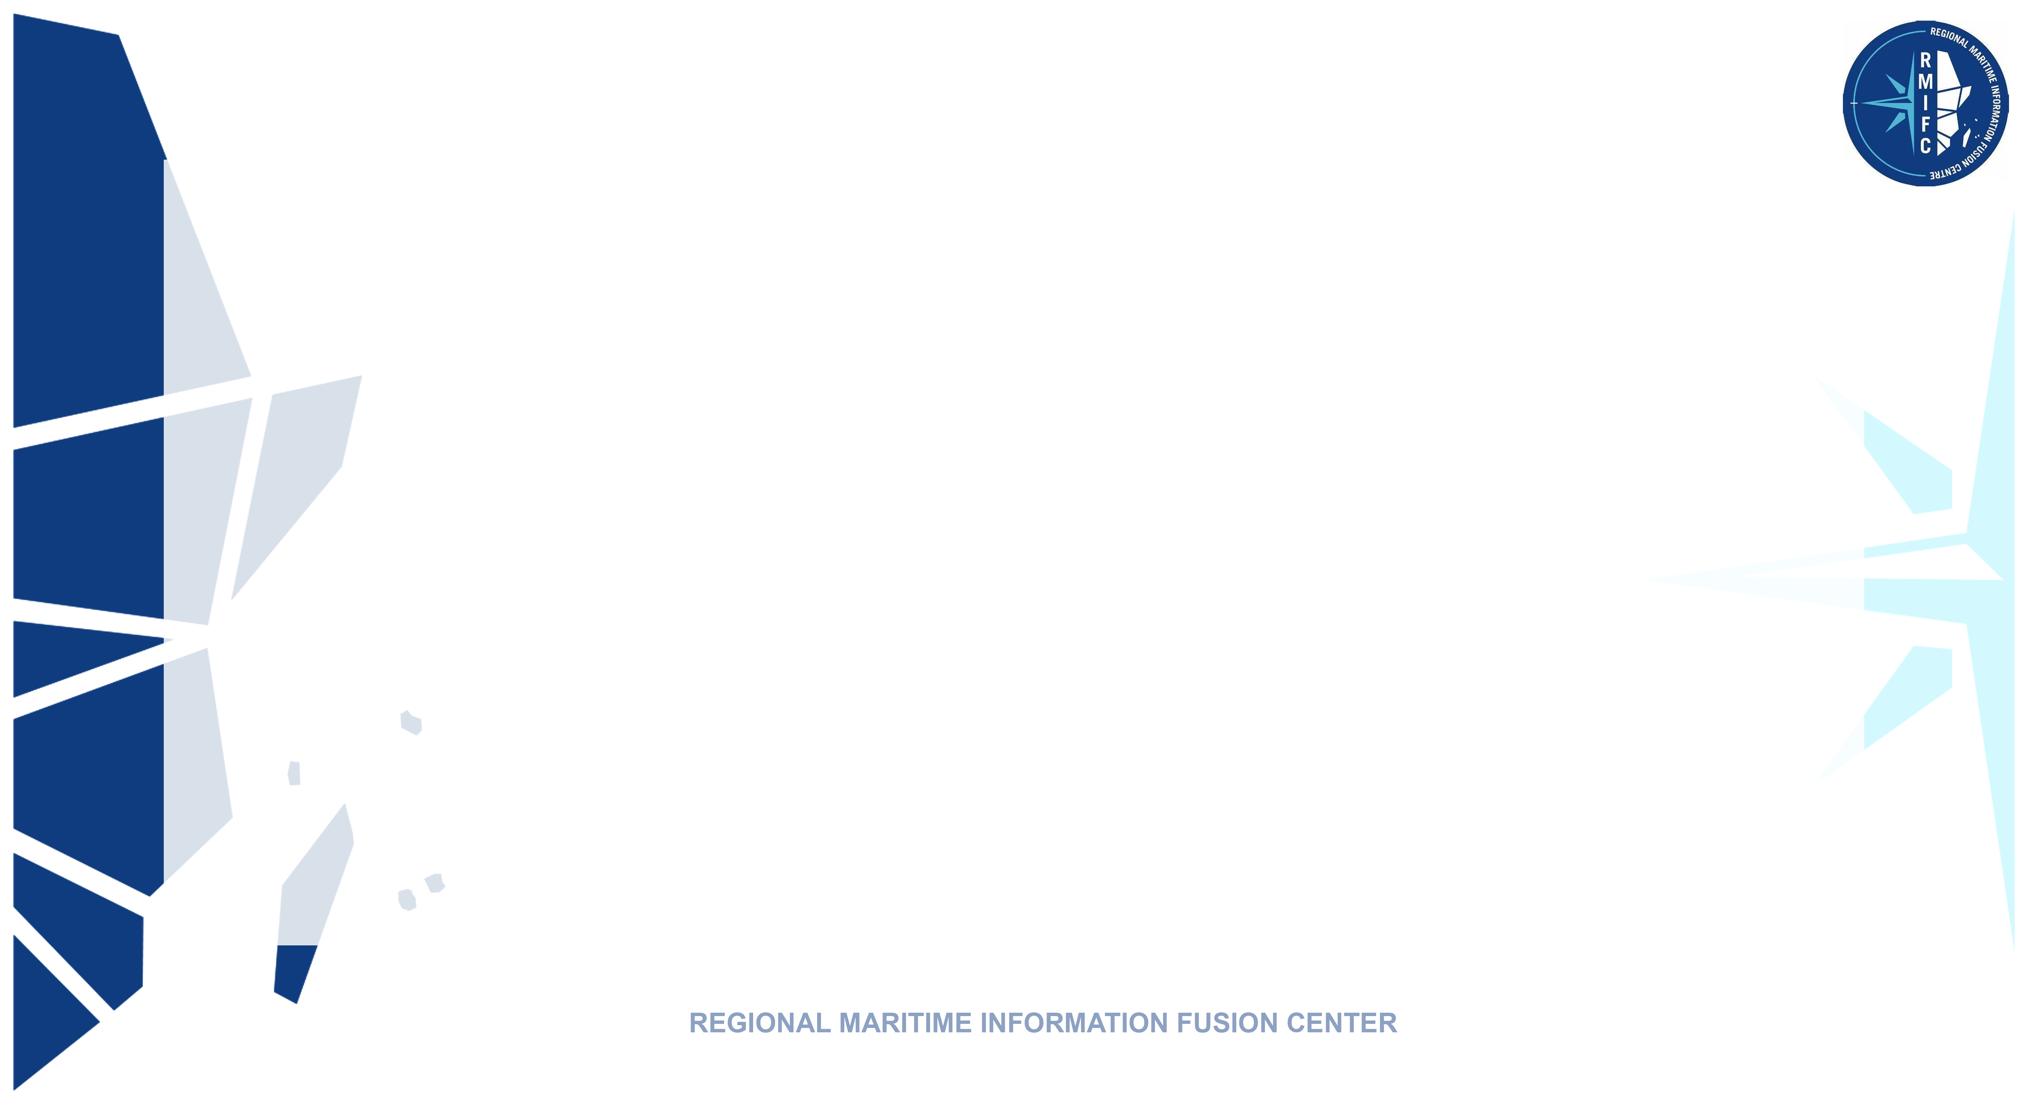
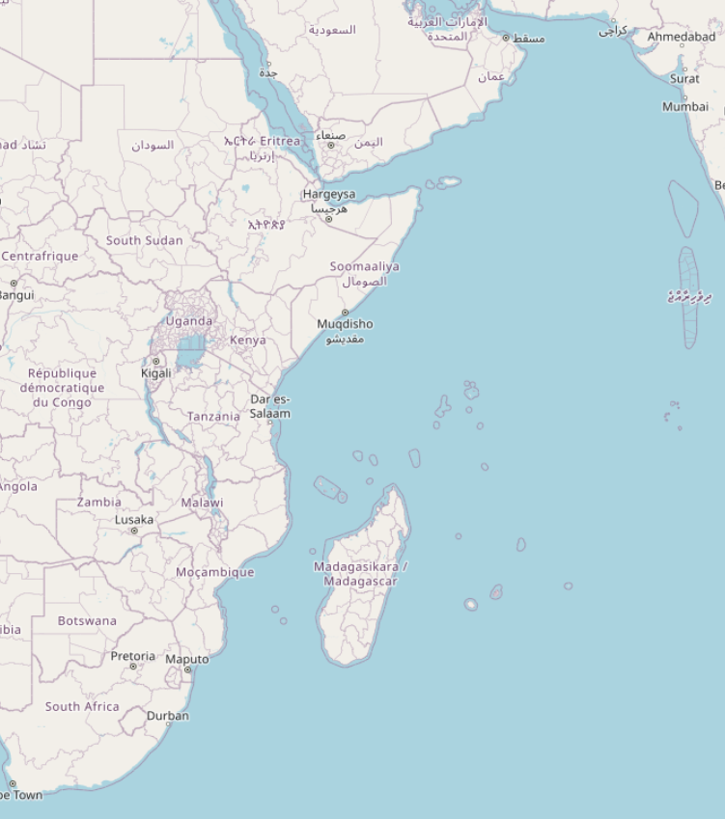
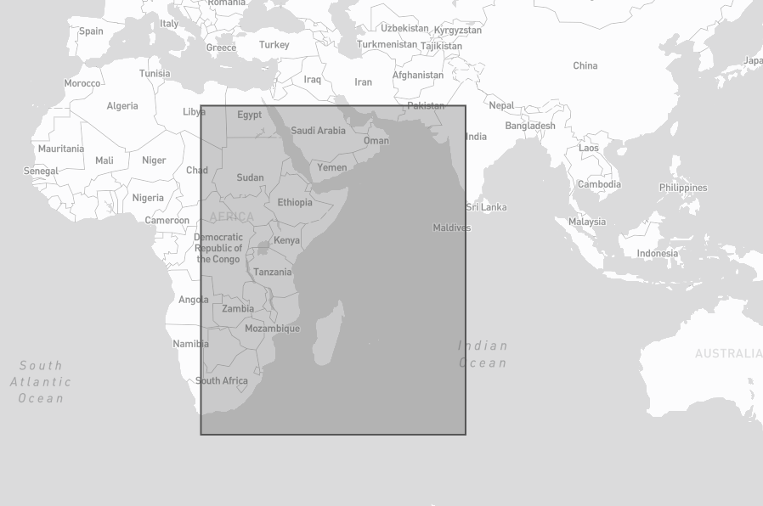
Violent acts at sea
(piracy, maritime terrorism, armed robbery, maritime extension of conflicts and armed reprisals) (*)
(Ops) RED SEA - Houthis target a merchant vessel.
27.06.2024, source: ILO France
On June 27th at 0645 UTC, an attack has taken place 83NM southwest of Al Hudaydah involving a waterborne improvised explosive device on a vessel identified as the Greek-owned, Malta-flagged Panamax bulker Seajoy. The vessel and crew are reported as safe, and the vessel is proceeding to their next port of call.
(*) - Maritime piracy: Suspicious approach, Approach with fire, Pirate attack
- Armed robbery on board ships
- Maritime conflict extension: mine traps or other actions against merchant ships in the context of the conflict in Yemen
- Armed reprisals: fishermen or others who shoot each other
- Maritime terrorism

Slide 9
Illegal, Unreported &
Unreported Fishing (IUU)
(Ops) BAHRAIN - Man caught with 300kg of illegally caught shrimp jailed
26.06.2024, source: Bahraini press
A Bahraini man has been sentenced to three months in prison for selling and trading in shrimp during the ban period. He was arrested with around 300kg of illegally caught shrimp which has been seized.

Slide 10
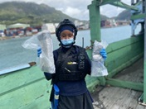
Trafficking & Smuggling
By Sea
(News) WORLD - World Drug Day: Strengthening maritime security
28.06.2024, source : UNODC
Maritime routes have long been exploited by drug traffickers due to the vast expanses of open sea and the complexity of maritime laws and jurisdictions. The illicit drug trade via maritime channels poses severe threats, not only in terms of drug proliferation but also through its links to organized crime, terrorism, and human trafficking. Addressing these challenges requires a coordinated international response, where the United Nations Office on Drugs and Crime Global Maritime Crime Programme (UNODC GMCP) plays a vital role.

Slide 11
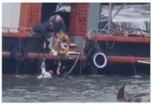
Maritime Incidents (*)
(Ops) SOUTH AFRICA - Rescue of a man swept out to sea
27.06.2024, source: NSRI
On June 23rd, 02 local fishermen heroically saved a man swept off the St Francis harbour wall by a massive wave. Their quick actions, supported by the NSRI, prevented a tragedy. At 1:28 PM, the NSRI Francis Bay duty crew was activated following reports of a man in his 40s being washed off the harbour wall and into the port. The escalating weather conditions and the Spring Tide had made the sea particularly treacherous. Local fishermen, who were preparing their Chokka fishing boat for the season, immediately noticed the man's peril and sprang into action. The rescued man was treated for non-fatal drowning symptoms and hypothermia. After being checked by paramedics, he declined transportation to the hospital.
(*) Maritime Incidents : Incidents of Civilian Security at Sea (Search and Rescue, Marine Pollution and Maritime Assistance)

Slide 12
Maritime Incidents (*)
(Ops) SOUTH AFRICA - Non-fatal drowning at Wilderness Beach
27.06.2024, source: NSRI
At 13h35, Wednesday, 26 June, NSRI Wilderness duty crew were activated following an eyewitness report from a local resident reporting a drowning in progress at Wilderness Beach near to Touw River Lagoon Mouth. While responding to the scene it was confirmed by the eyewitness that 2 males were in the water appearing to be caught in rip currents. On arrival on the scene 1 of the casualties was out of the water, on the beach and in need of medical care, and 1 of the casualties was still in the water but close to shore and he exited the water without assistance. The casualty requiring medical care, a 19-year-old male, was treated by NSRI medics, EMS paramedics and ER24 paramedics, for hypothermia and for non-fatal drowning symptoms. His cousin, age 17, was not injured.
(*) Maritime Incidents : Incidents of Civilian Security at Sea (Search and Rescue, Marine Pollution and Maritime Assistance)

Slide 13
Maritime Incidents (*)
(Ops) SOUTH AFRICA - A boat taking on water after being hit by a wave
27.06.2024, source: NSRI
On Sunday, 23 June, at 08h30, NSRI Port Alfred duty crew were activated following reports from 2 crew of a boat taking on water after being hit by a wave in the Kowie River Mouth, while exiting the Kowie River to go to sea, and adrift in distress with motor mechanical failure. On arrival on the scene, both local men had abandoned their boat that was washing towards the Pier. Both rescued from the water onto our rescue craft. The stricken boat had drifted out of the river mouth where it was fitted with a towline and towed further away from the river mouth to a safe distance of about one nautical mile out to sea, where it was safely anchored.
(*) Maritime Incidents : Incidents of Civilian Security at Sea (Search and Rescue, Marine Pollution and Maritime Assistance)

Slide 14
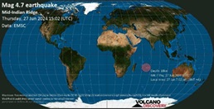
Natural Event /HADR
(Act) INDIAN OCEAN - Earthquake mag. 4.7 in the Indian Ocean
27.06.2024, source: Volcanodiscovery
A strong earthquake of magnitude 4.7 occurred in the Indian Ocean in the late afternoon of Thursday June 27, 2024 at 7:02 pm local time (GMT +4). The earthquake had a very shallow depth of 10 km and was not felt (or at least not reported as such). The nearest large town where the quake could be felt is Port Mathurin, a town of 6,000 inhabitants located in Mauritius, 400 km (248 mi) west of the epicenter. Residents probably felt very weak tremors there.

Slide 15
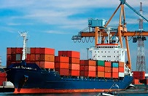
Critical Infrastructure
(News MOZAMBIQUE - Mozambique: Port of Beira achieves record cargo handling figures
27.06.2024, source: Mozambican press
The private consortium Cornelder de Moçambique, responsible for managing the port of Beira in central Mozambique, has announced that over the last five months it has achieved record figures in cargo handling. According to the company's Managing Director, Jan De Vries, from January to May this year, 161,000 containers were handled at the Port of Beira, compared with 102,000 during the same period last year. In the general cargo terminal, 1.6 million tonnes were handled, compared with 1.4 million in the first half of last year.

Slide 16
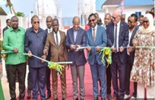
Critical Infrastructure
(News) TANZANIA - Mwinyi launches a gas storage terminal
27.06.2024, source : Ippmedia
Celebrating the inauguration of the first liquefied petroleum gas (LPG) terminal at the port in the Unguja North region, the President urged businesses to contribute and build more supporting infrastructure, including oil and gas depots at the port.

Slide 17
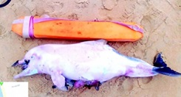
Marine
Environment
(News) INDIA - Wildlife rescuers ask public help after spate of marine life emergencies
28.06.2024, source: Indian press
Wildlife conservationists in Goa are urgently appealing to the public after a series of incidents involving injured marine wildlife along the State's coastline. They are urging beachgoers to inform authorities immediately if they come across such cases, emphasizing how crucial timely intervention is in protecting these vulnerable animals. Goa's beaches have recently seen dozens of stranding incidents on Wednesday alone, an Indian Ocean Humpback Dolphin calf washed up dead on Calangute beach, and a green turtle was rescued alive on the same stretch.

Slide 18
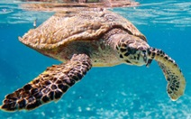
Marine
Environment
(News) TANZNIA - Actions to strengthen marine turtle conservation agreed at UN meeting in Tanzania
27.06.2024, source: Nigerian press
Governments, scientific experts and stakeholders gathered for four days at an international meeting that ended on Thursday, June 27, 2024, to discuss urgent marine turtle conservation issues in the Indian Ocean and Southeast Asia region.

Slide 19
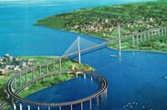
Others
(News) TANZANIA - New fisheries agreement promises significant advances
27.06.2024, source : Senego.com
In Tanzania, fishing accounts for over 80% of the country's fish supply. To boost the sector's export earnings, the government is investing more in fishing infrastructure. To this end, Zanzibar's Minister of Blue Economy and Fisheries, Shaaban Ali Othman, signed a cooperation agreement with South Korea on Wednesday June 26, 2024. The agreement includes a feasibility study for the construction of a fishing port in the archipelago. The study will focus on the areas of Mangapwani and Mkokotoni in Unguja, as well as Micheweni and Shumba Viamboni in Pemba, to determine suitable sites on each main island for the project.

Slide 20
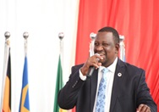
Others
(News) KENYA - Call for regional cooperation in the exploitation of maritime resources
27.06.2024, source: Kenyan press
Mining, Blue Economy, and Maritime Affairs CS Salim Mvurya has called for regional cooperation in harnessing maritime resources. The CS stressed that the journey towards a sustainable maritime future is a collective endeavour "Achieving a sustainable maritime future requires unprecedented regional cooperation and innovation," Mvurya said.

Slide 21

REGIONAL MARITIME INFORMATIONS FUSION CENTER
End of Briefing
PDC –Watchfloor
Mail: watchfloor@crfimmadagascar.org
Mobile: +261 38 09 301 22
MERCURY Identification: RMIFC
Website: https://crfimmadagascar.org
The text from various quoted news sources may have been modified/combined/collated in Information Centre products.
For the exact text, kindly refer to the corresponding news link. RMIFC is not responsible for the accuracy of open-source news information

